Slide 2

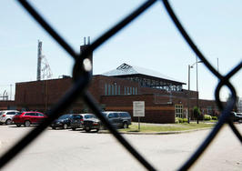
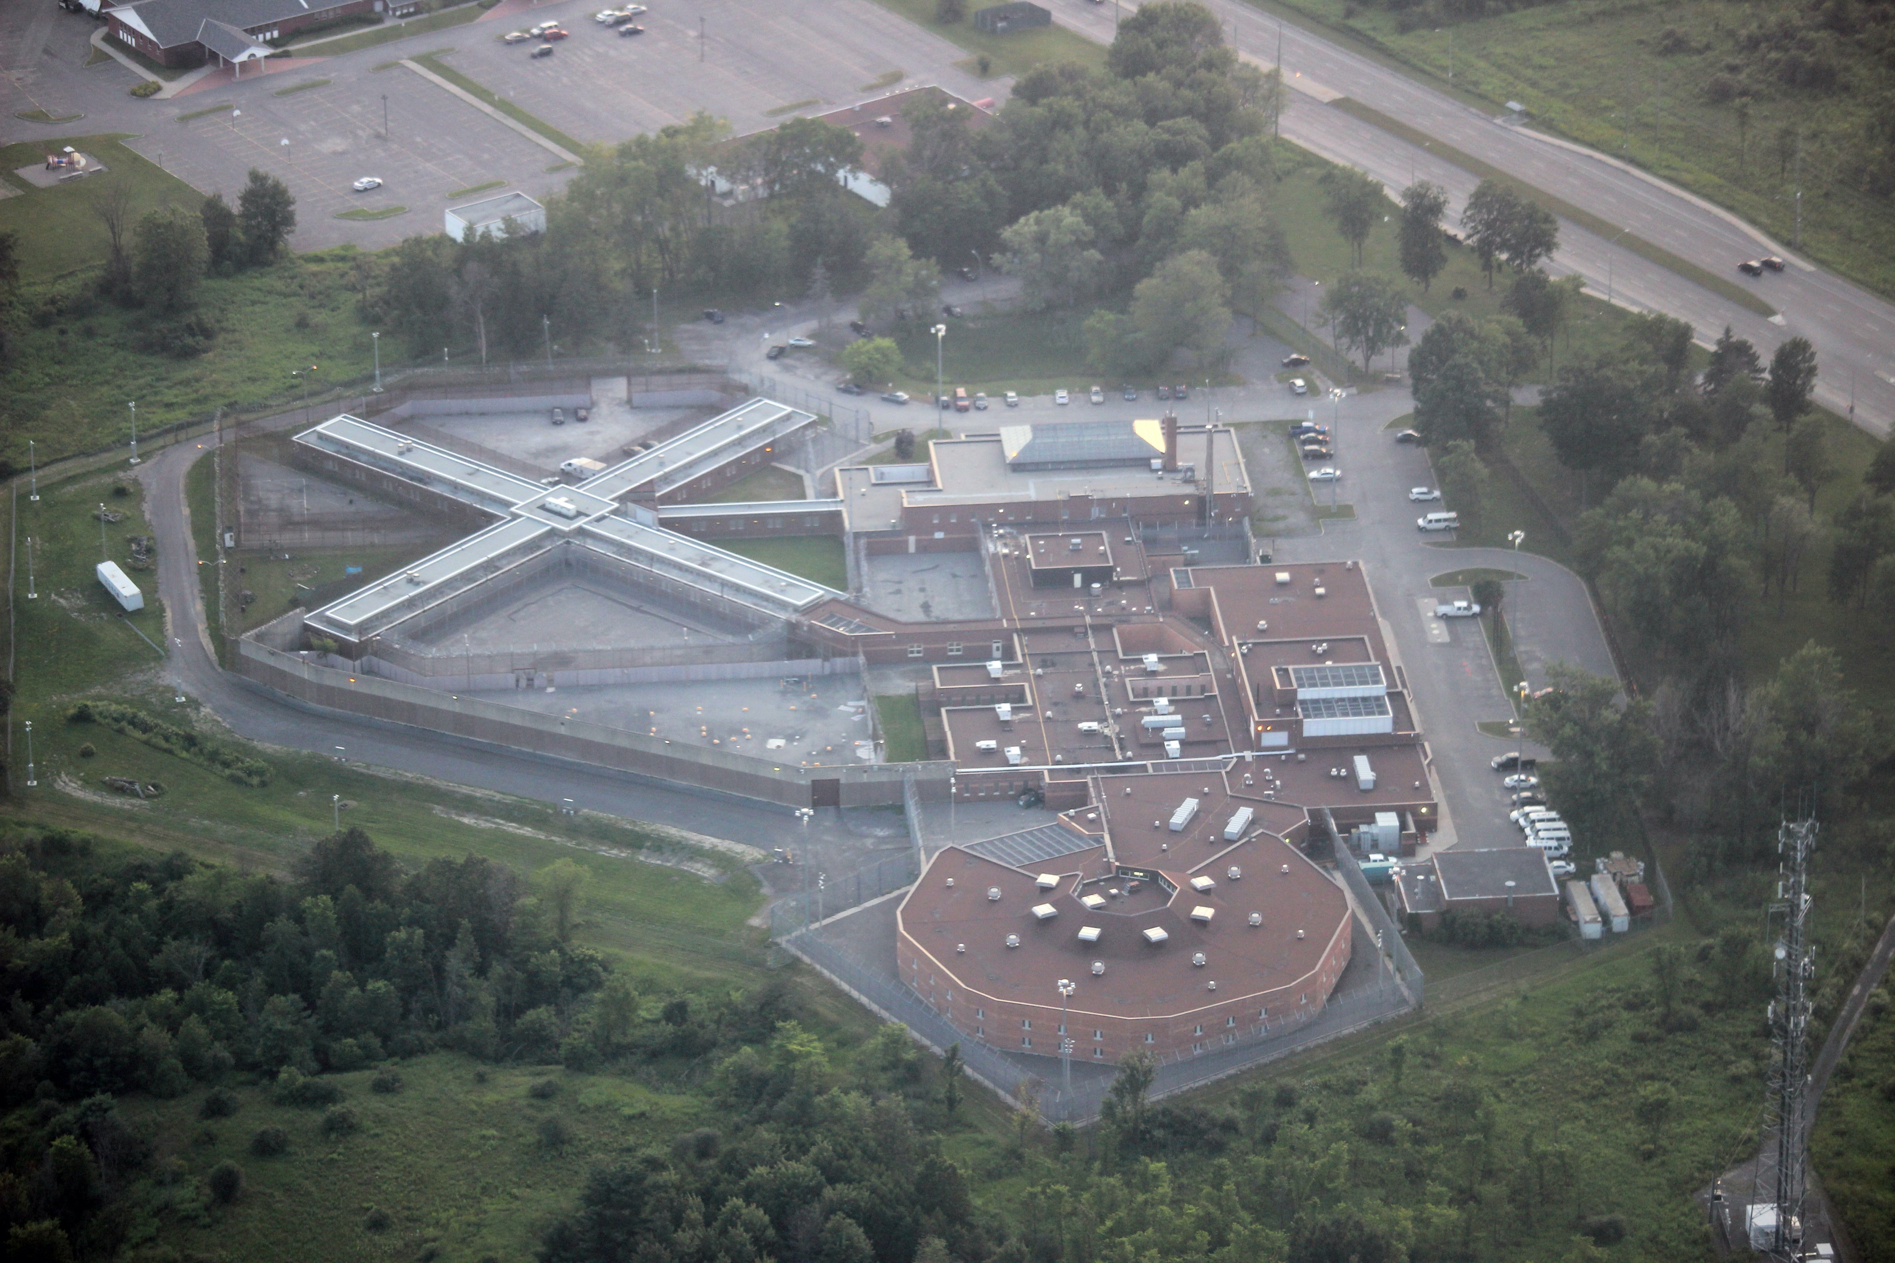
Call Me Anything, Just Do Not Call Me Late For Dinner
Rev. Carl Wake, Former Coordinating Chaplain
Ottawa-Carleton Detention Centre

Slide 3
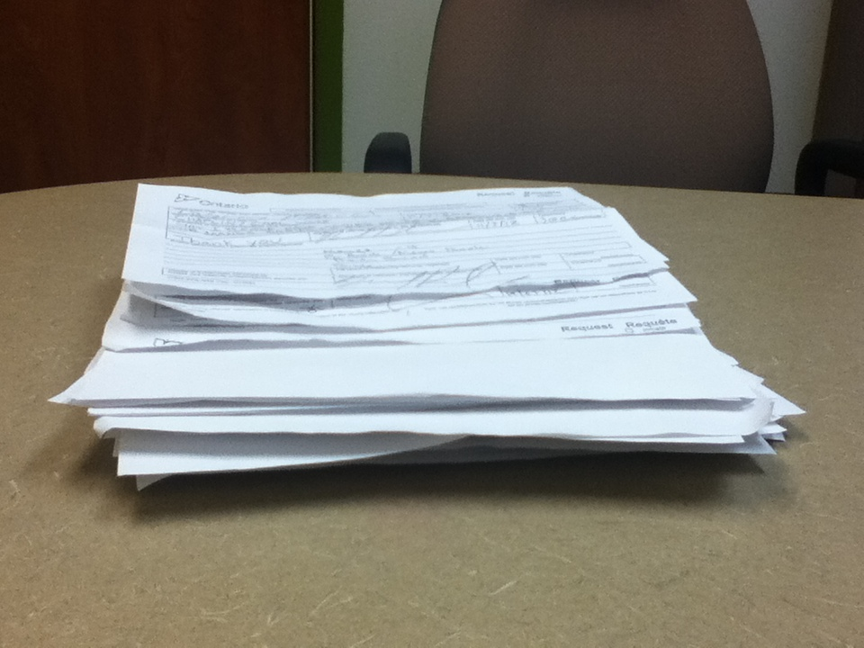
The following are but a sample of how I have been addressed over the years…

Slide 4
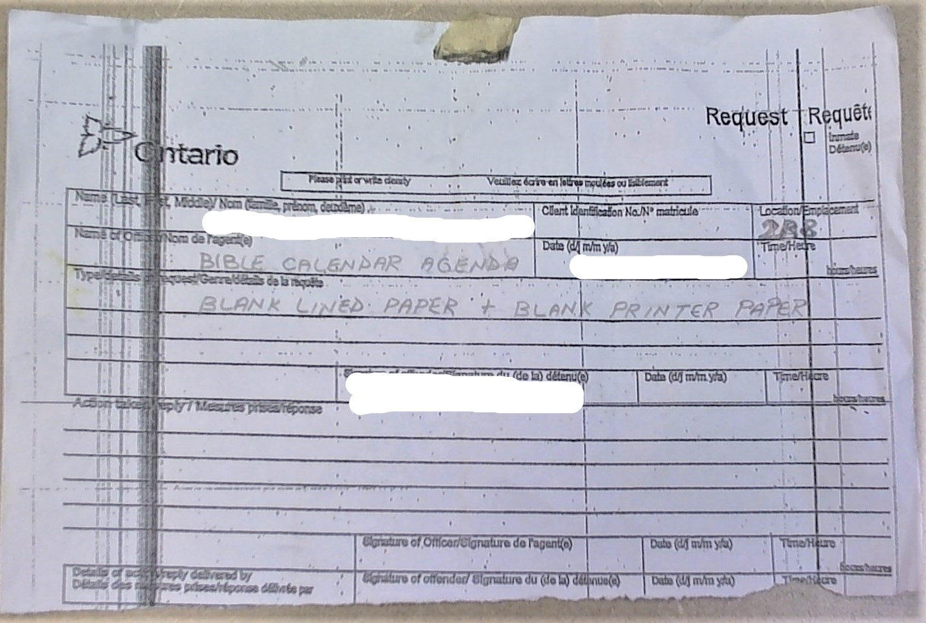
Bible Calendar Agenda, or Blank

Slide 5
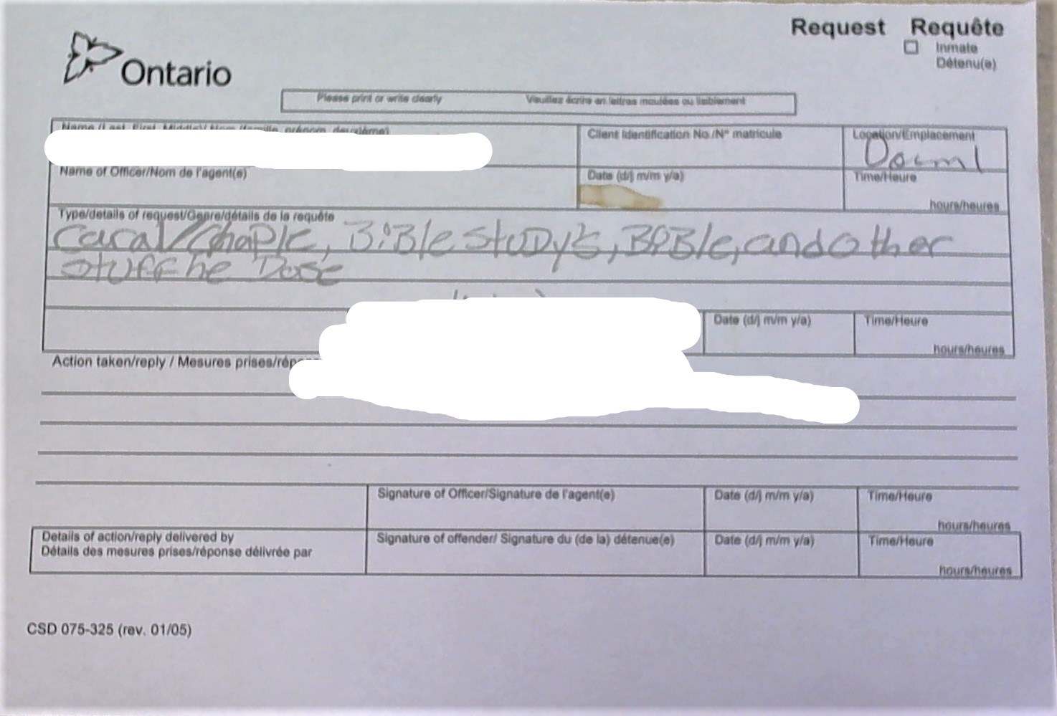
Caral / Chaple

Slide 6
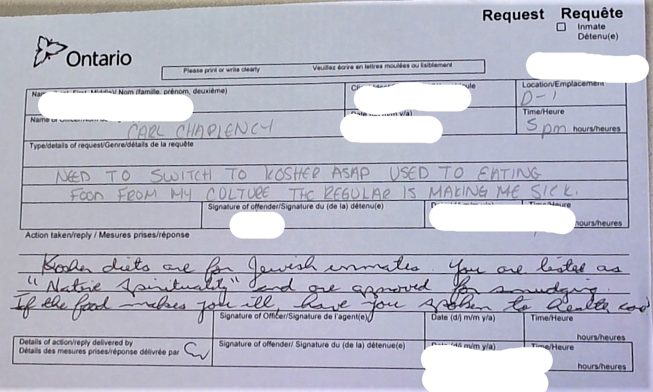
Carl Chaplency

Slide 7
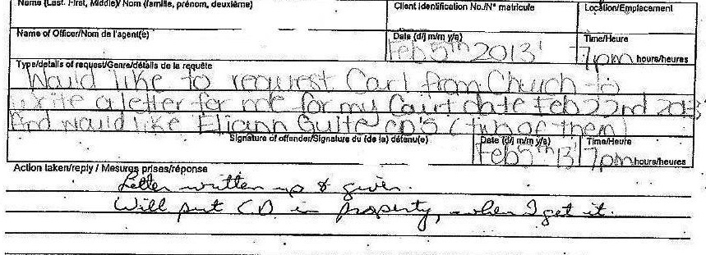
Carl from Church

Slide 8
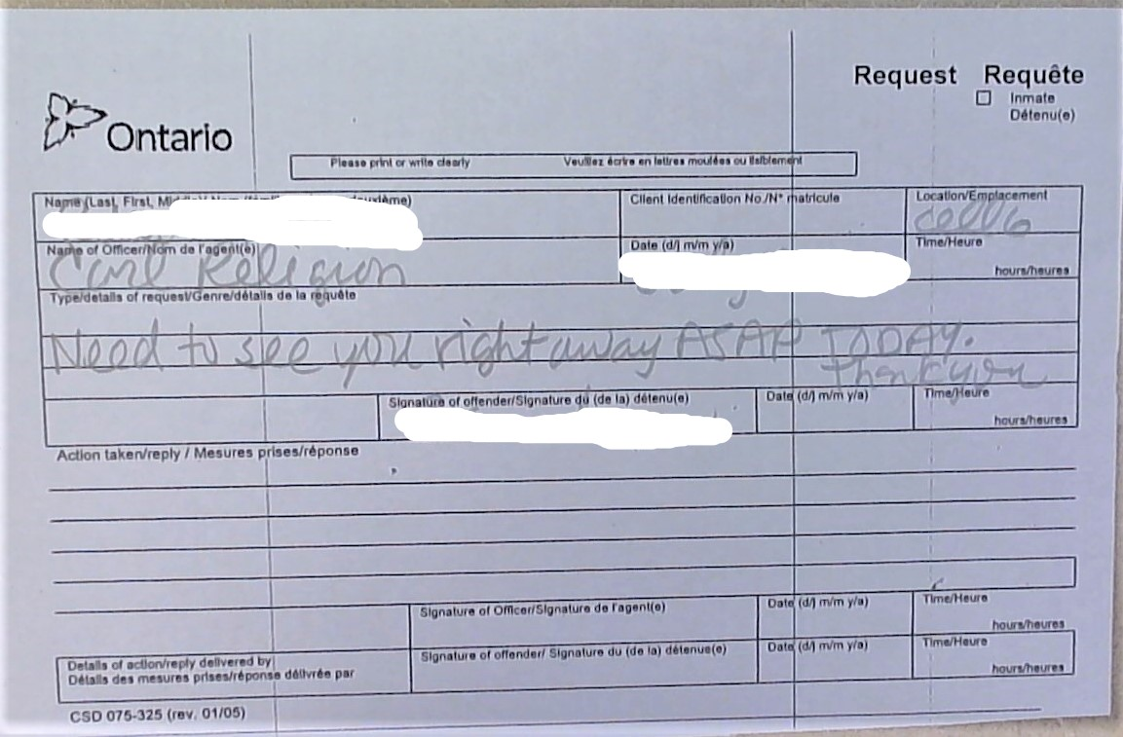
Carl Religion

Slide 9
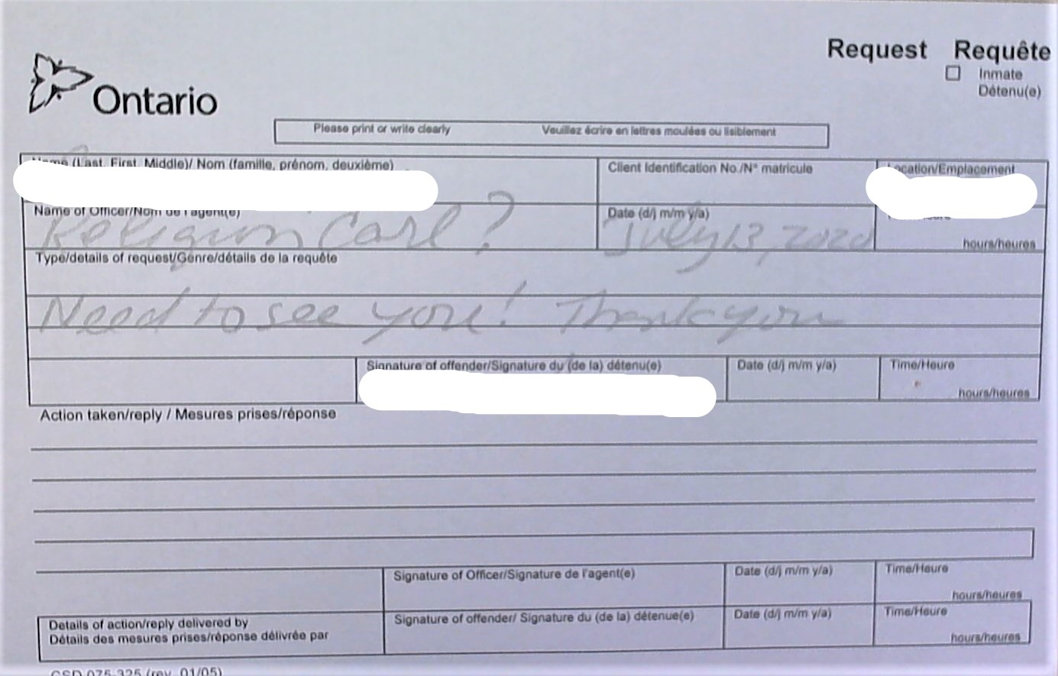
Religion Carl?

Slide 10
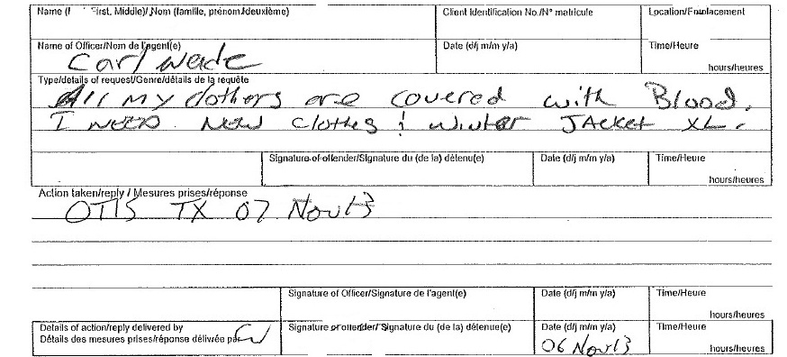
Carl Wade

Slide 11
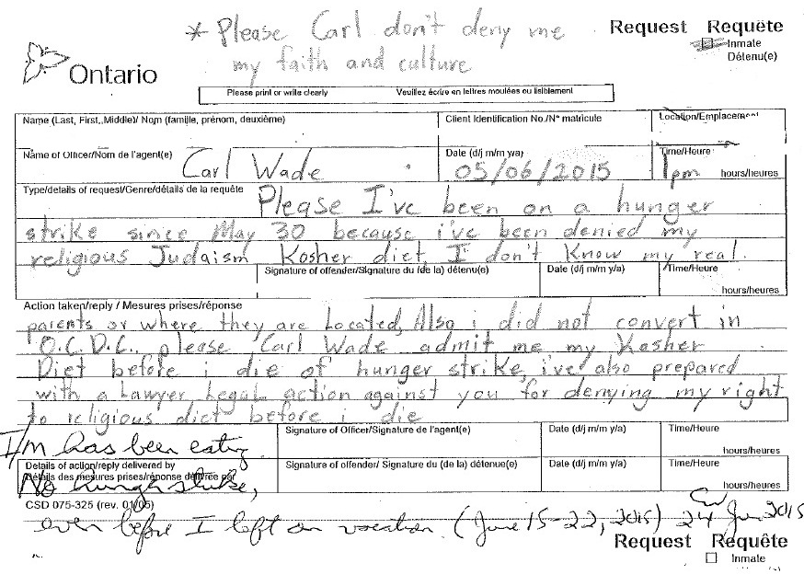
Carl Wade

Slide 12
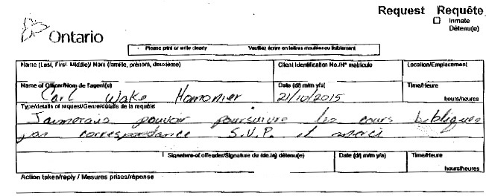
Carl Wake Homonier

Slide 13
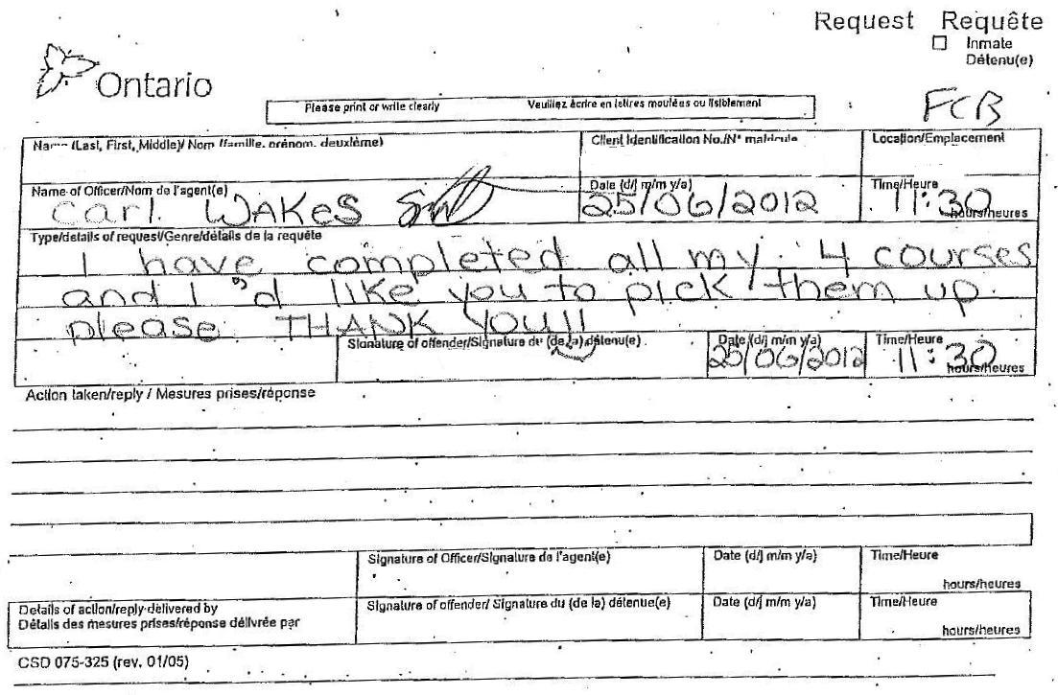
Carl Wakes

Slide 14
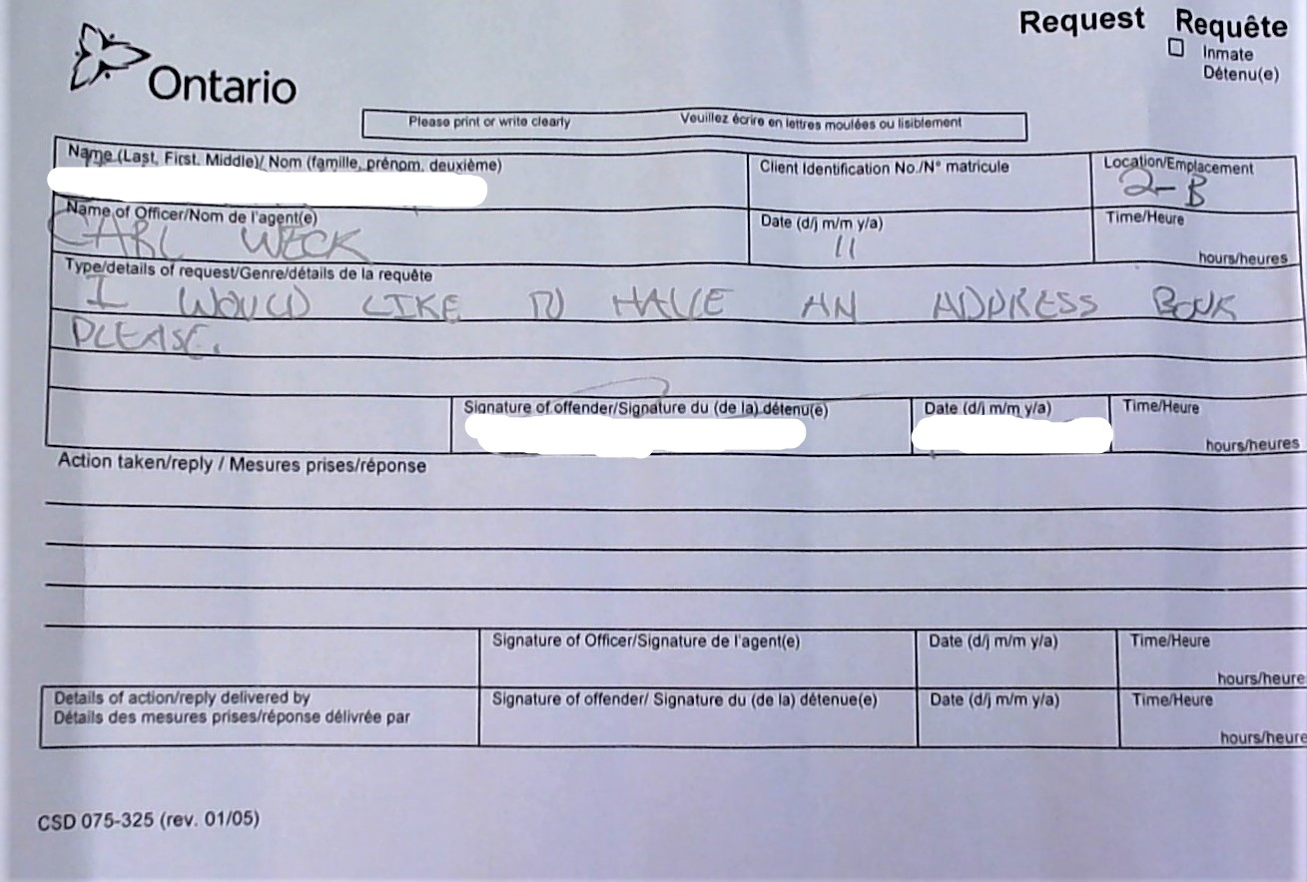
Carl Weck

Slide 15
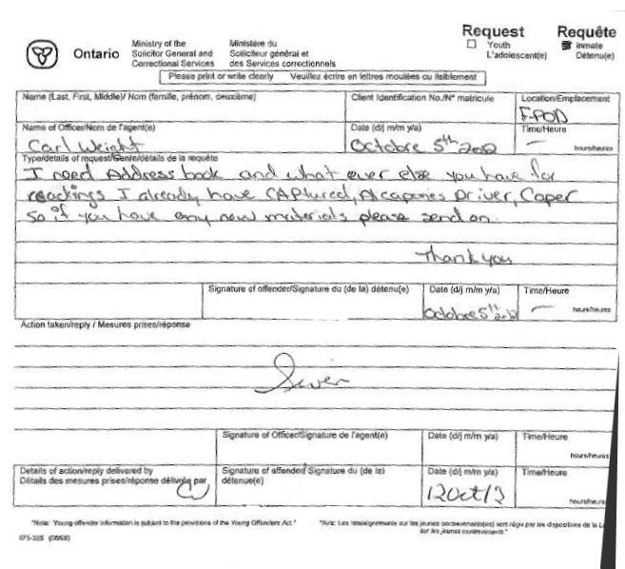
Carl Weight

Slide 16
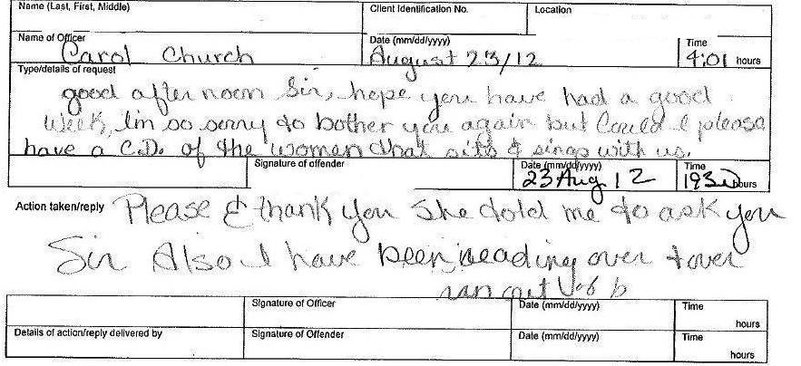
Carol Church

Slide 17
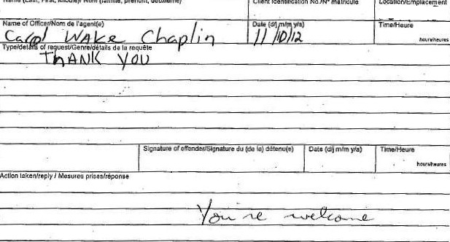
Carol Wake Chaplin

Slide 18
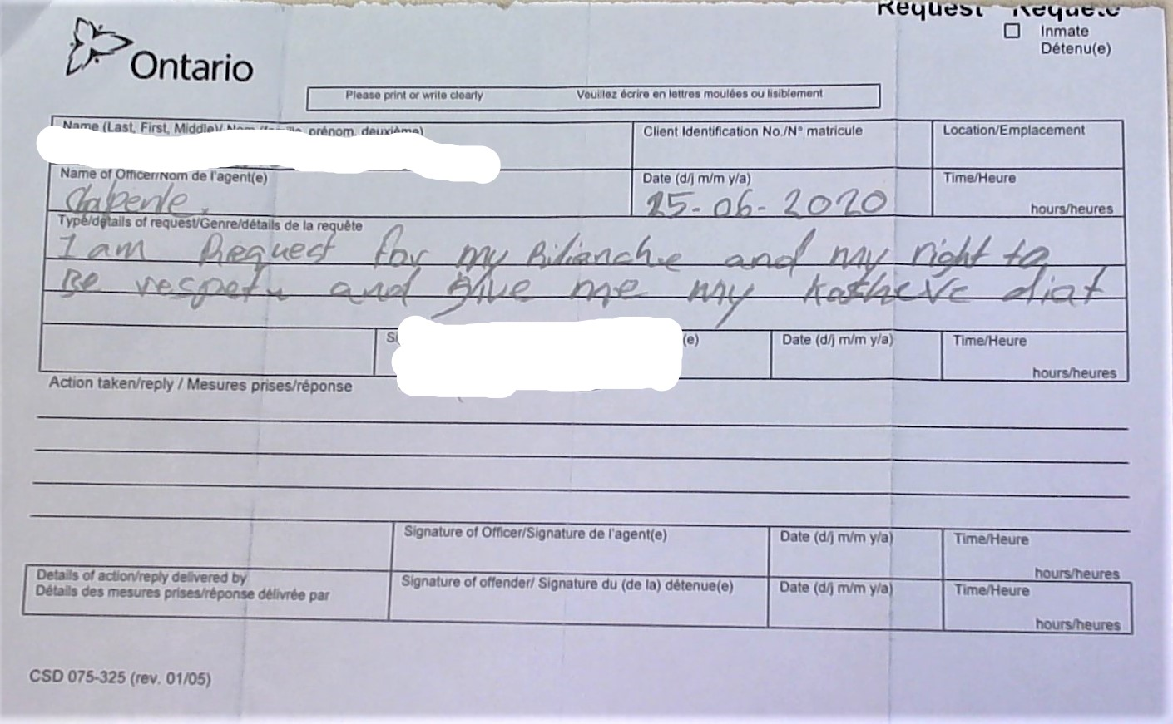
Chalpenle

Slide 19
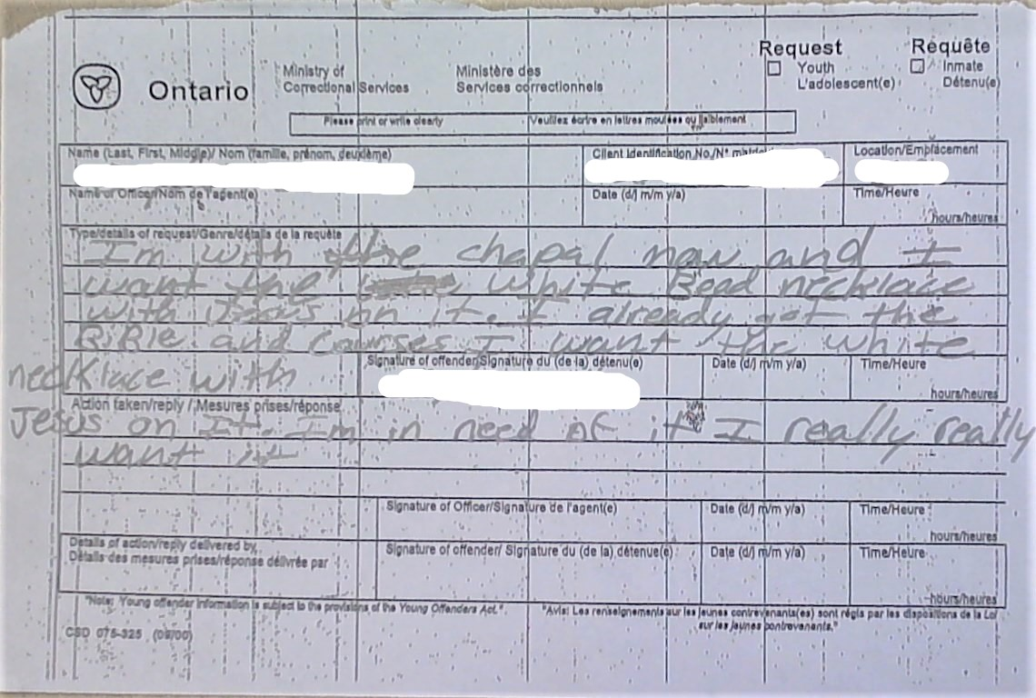
Chapal Man

Slide 20
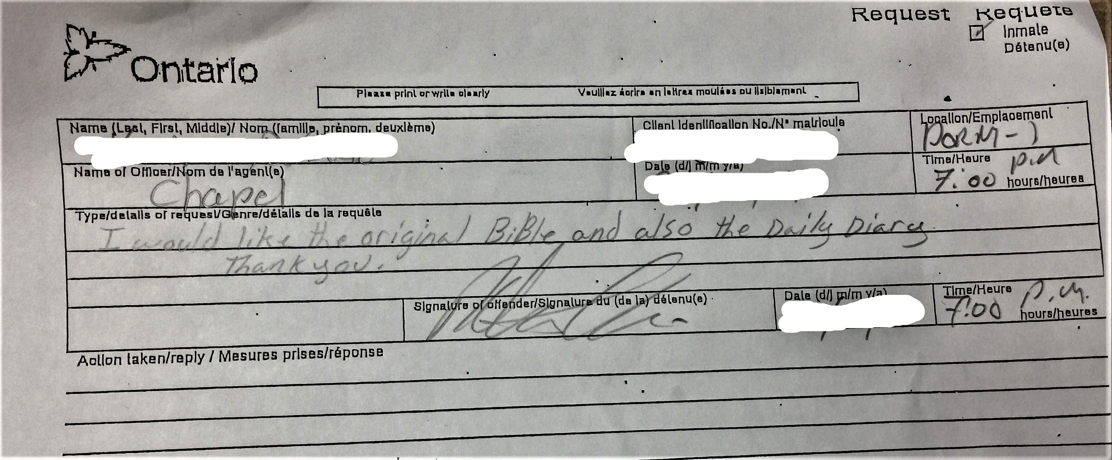
Chapel

Slide 21
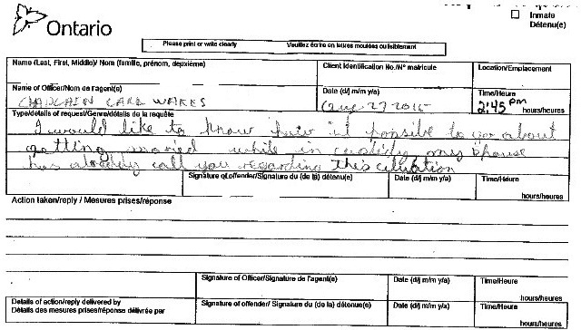
Chaplain Carl Wakes

Slide 22
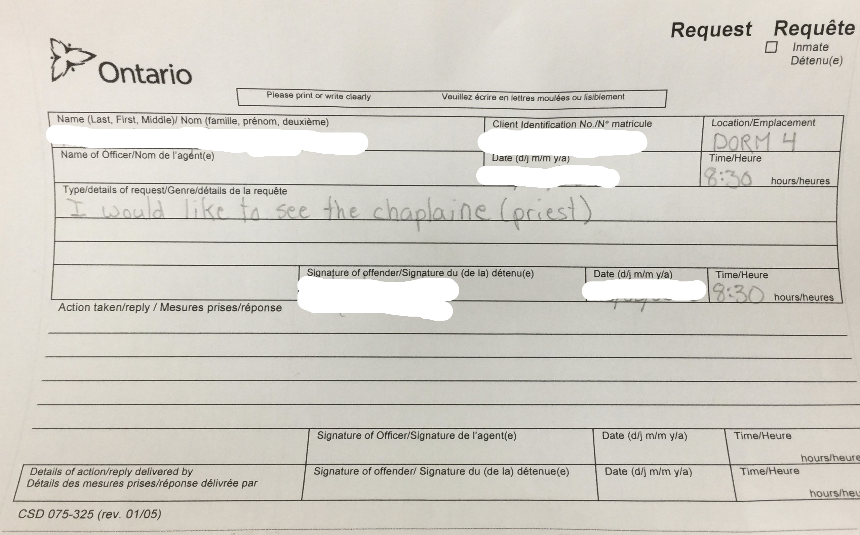
Chaplaine (Priest)

Slide 23
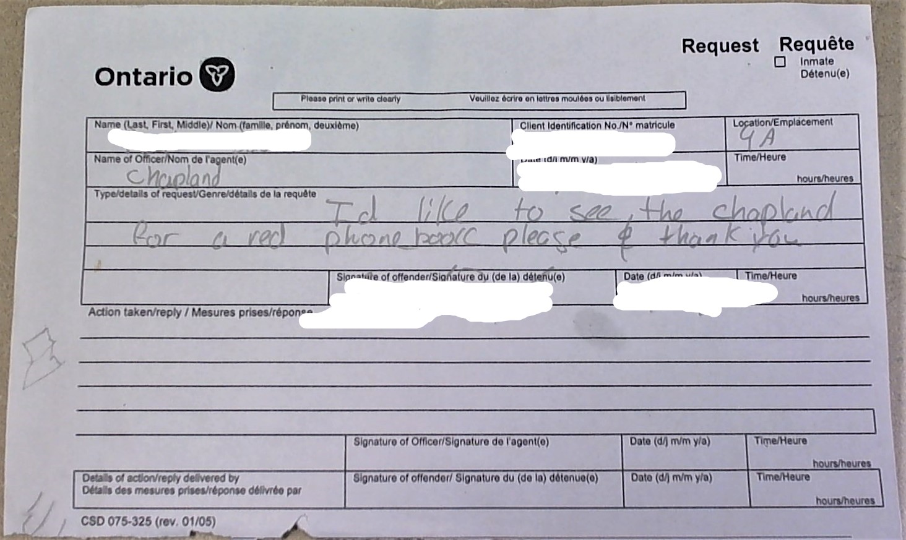
Chapland

Slide 24
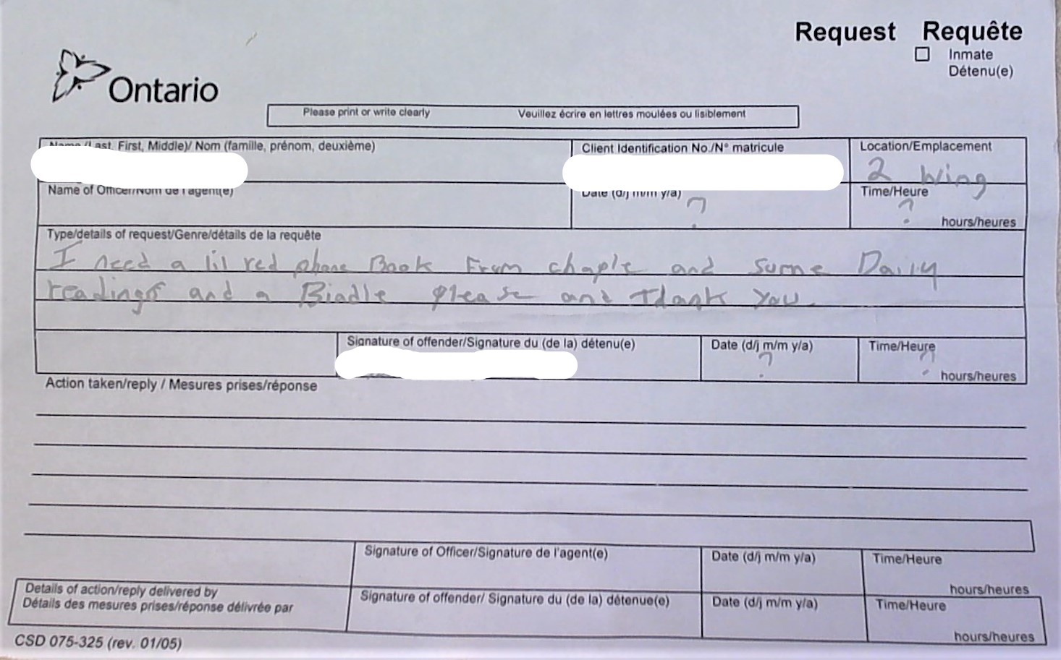
Chaple

Slide 25
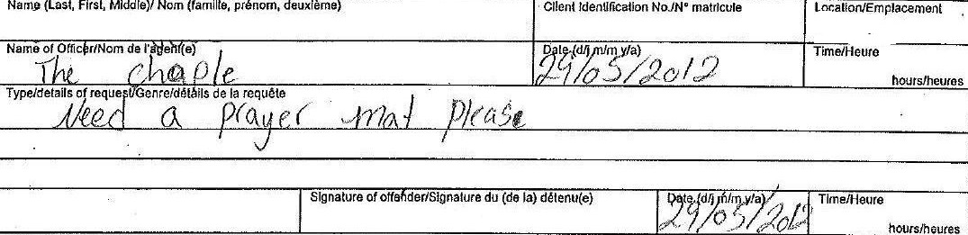
The Chaple

Slide 26
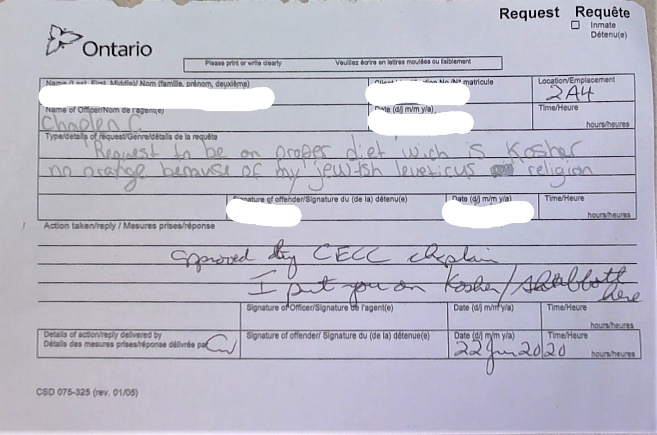
Chaplen C

Slide 27
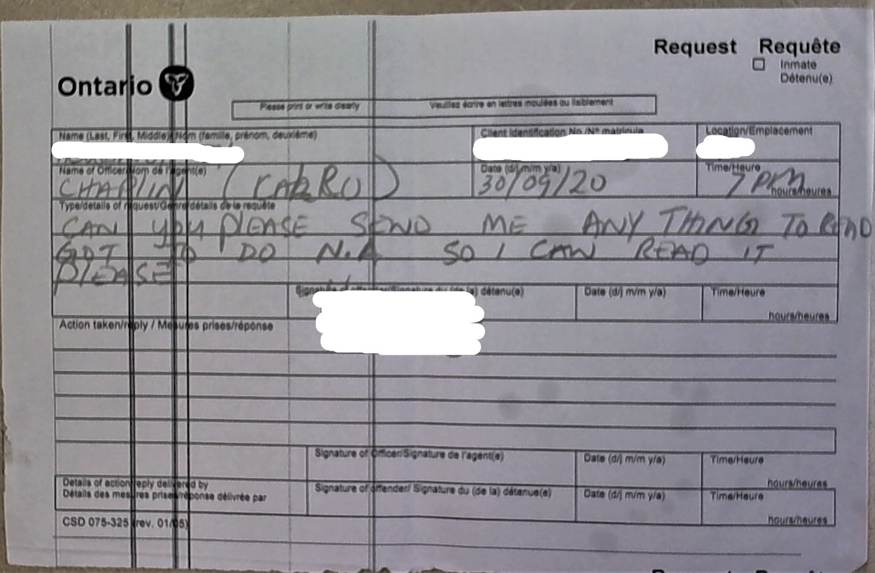
Chaplin Calro

Slide 28
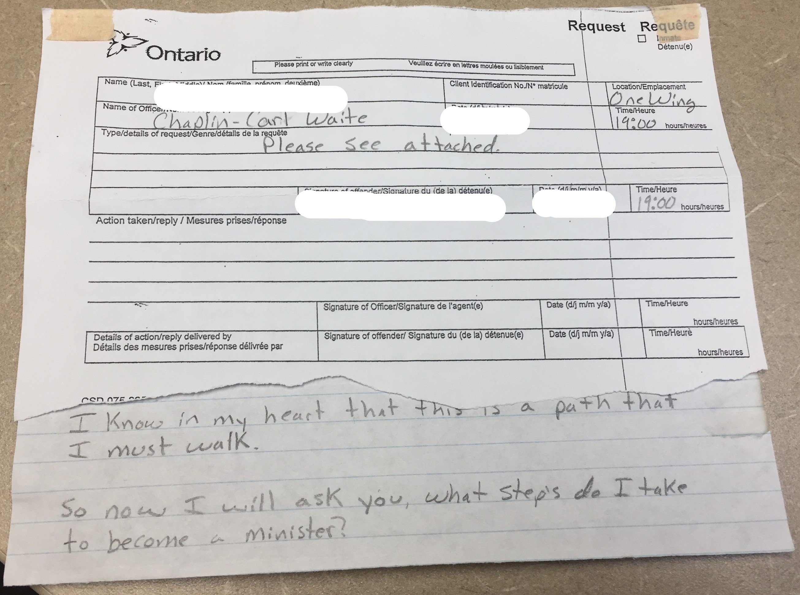
Chaplin Carl Waite

Slide 29
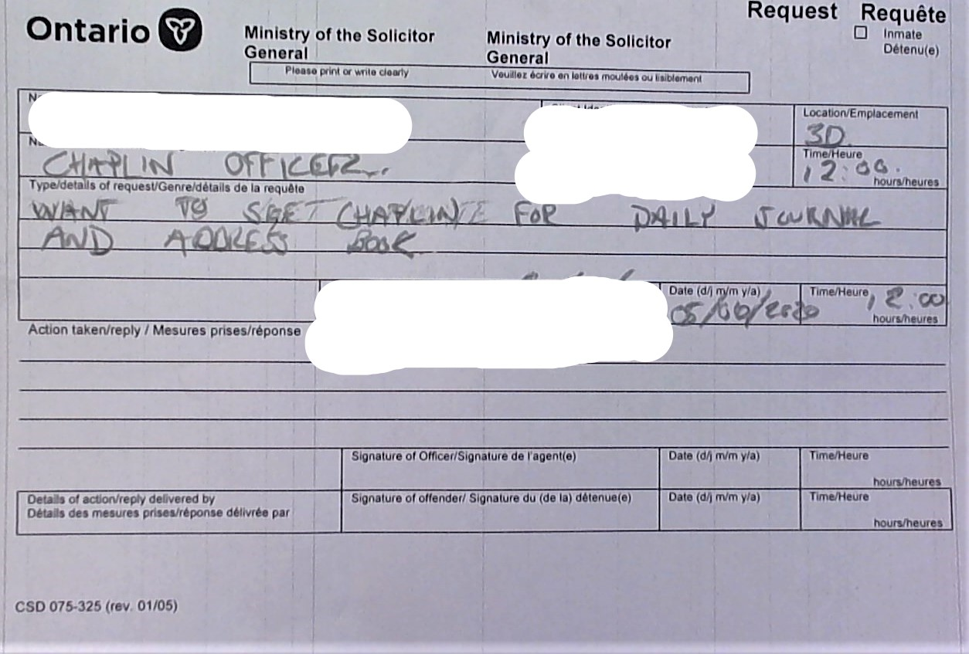
Chaplin Officer

Slide 30
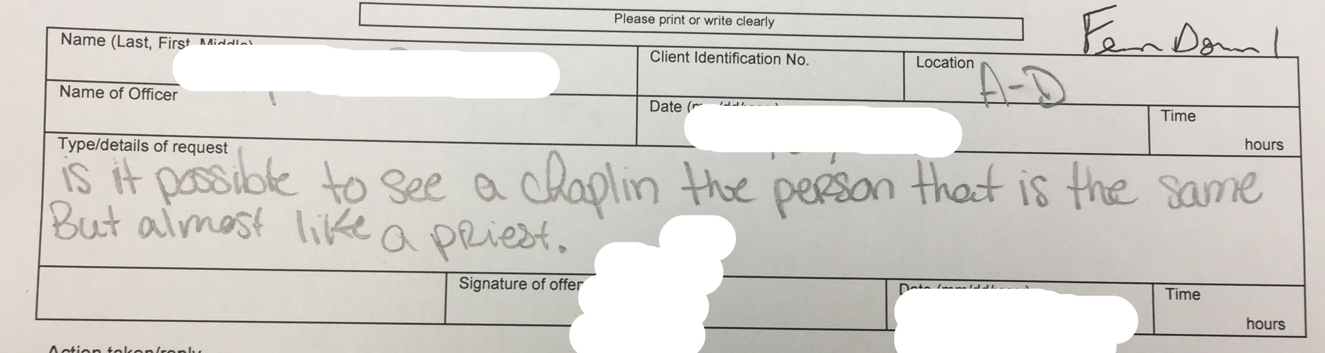
Chaplin the person that is the same, but almost like a priest

Slide 31
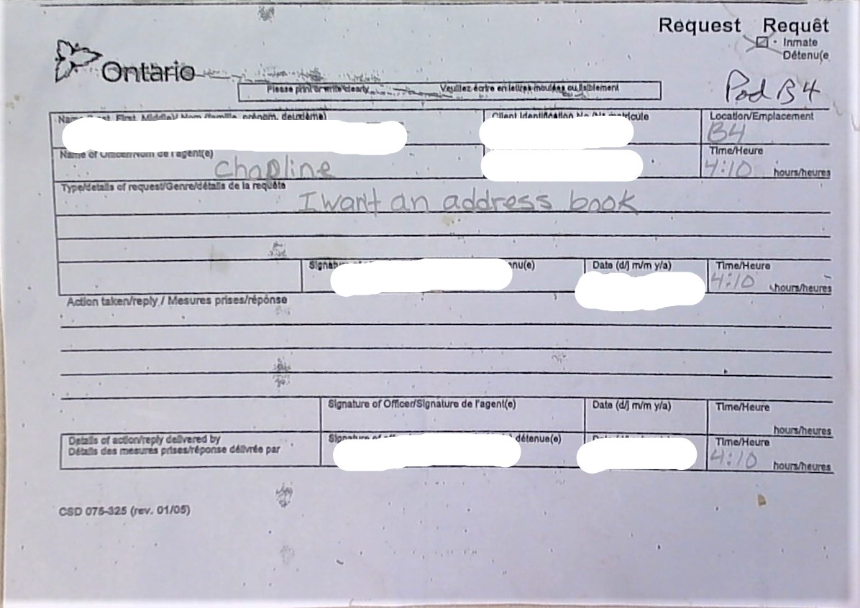
Chapline

Slide 32
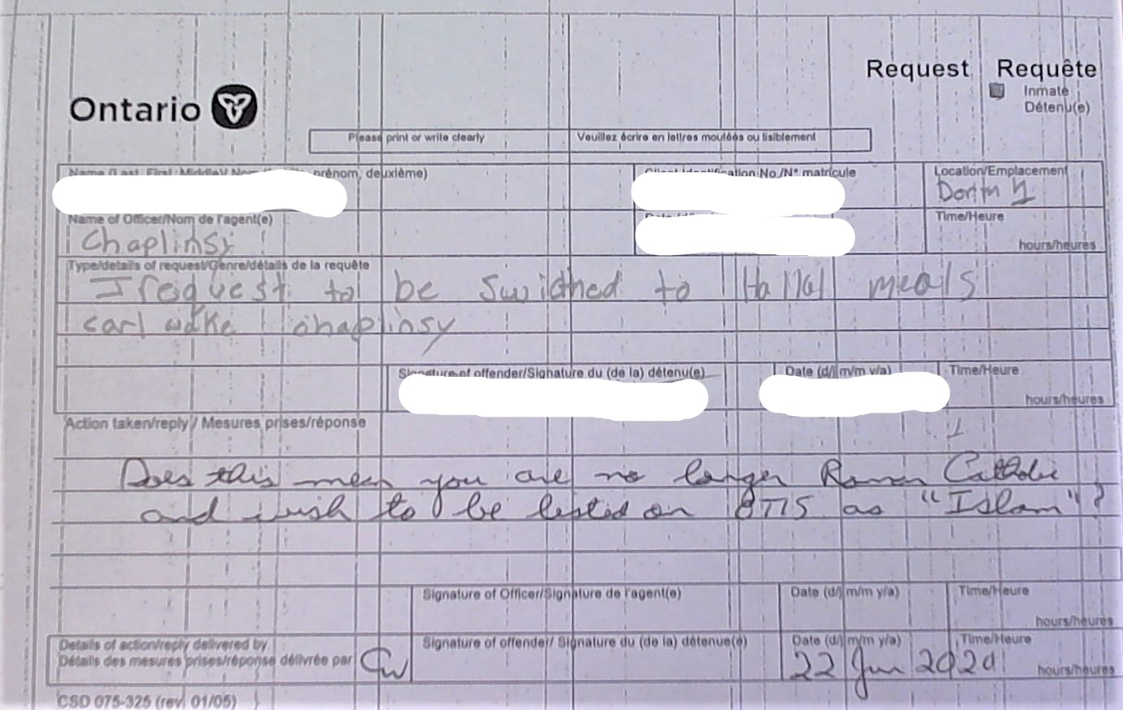
Chaplinsy

Slide 33
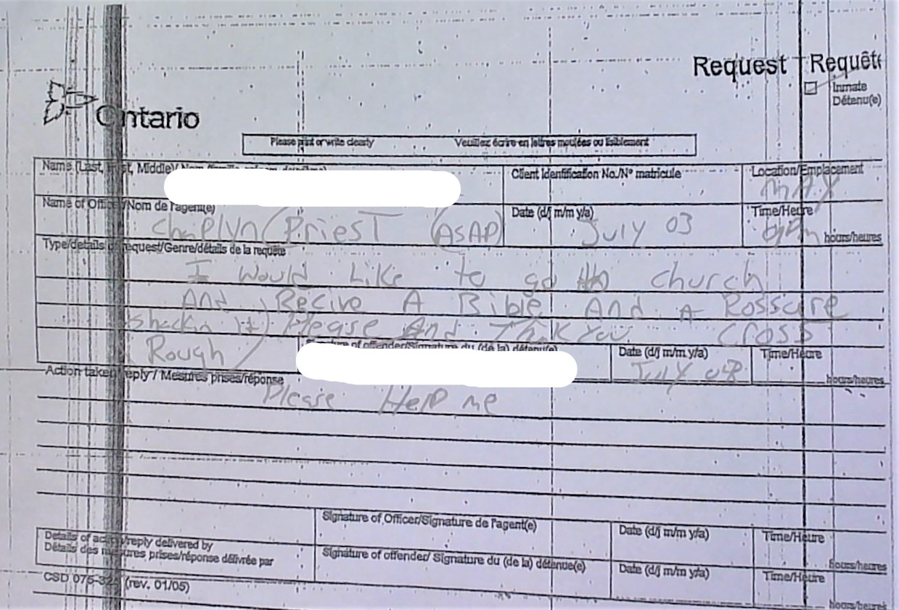
Chaplyn / Priest

Slide 34
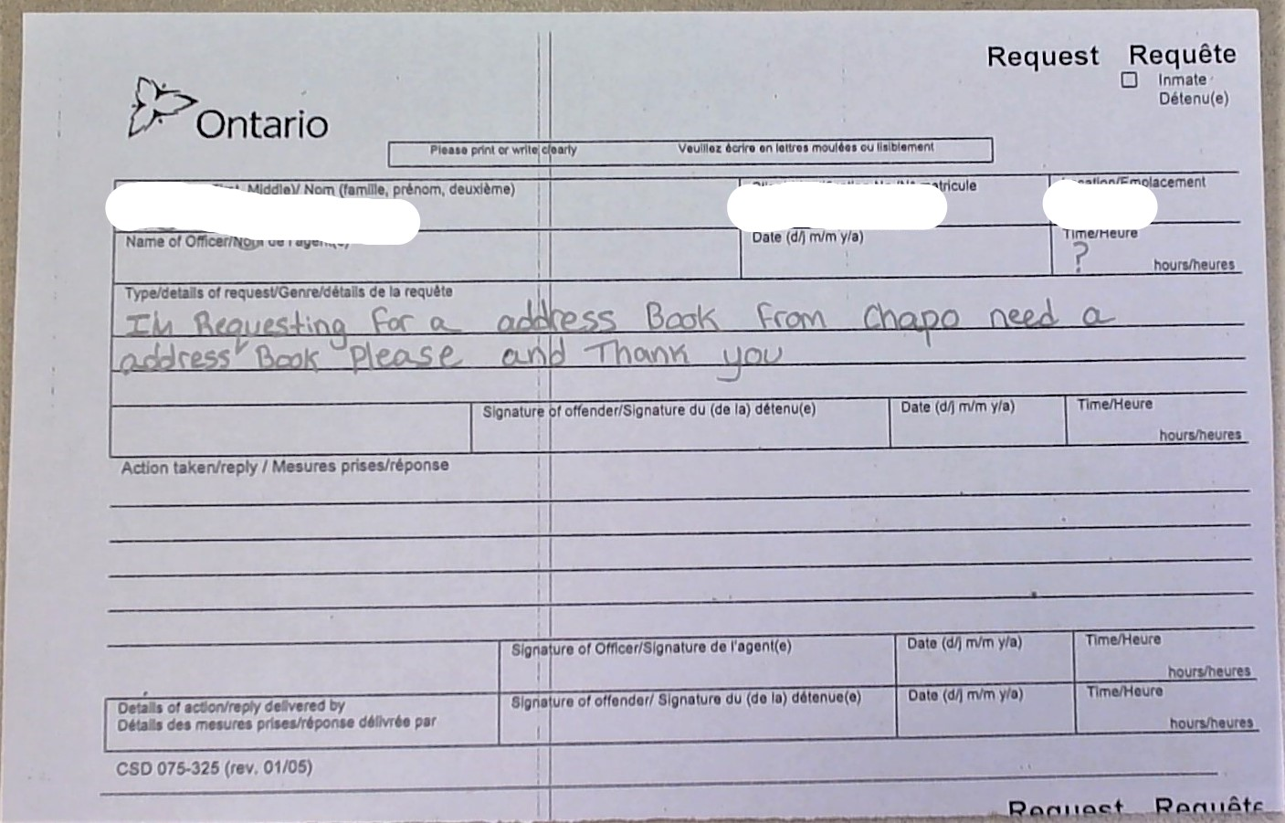
Chapo

Slide 35
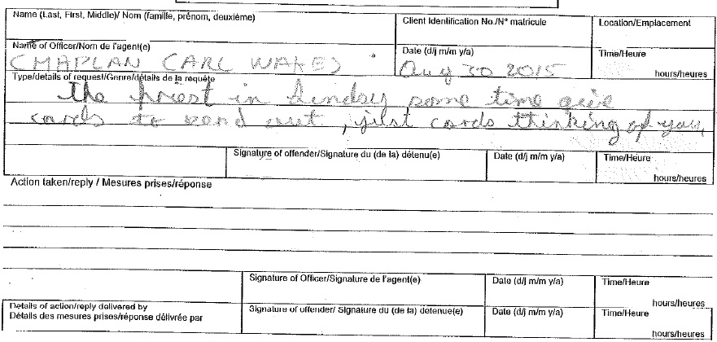
CMAPLAN CARL WAKES

Slide 36
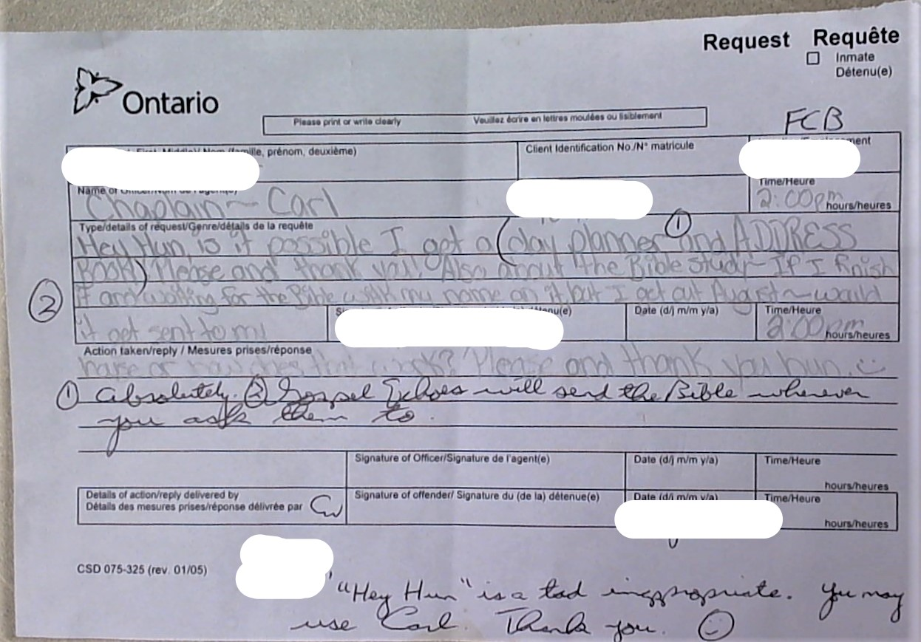
Hey Hun

Slide 37
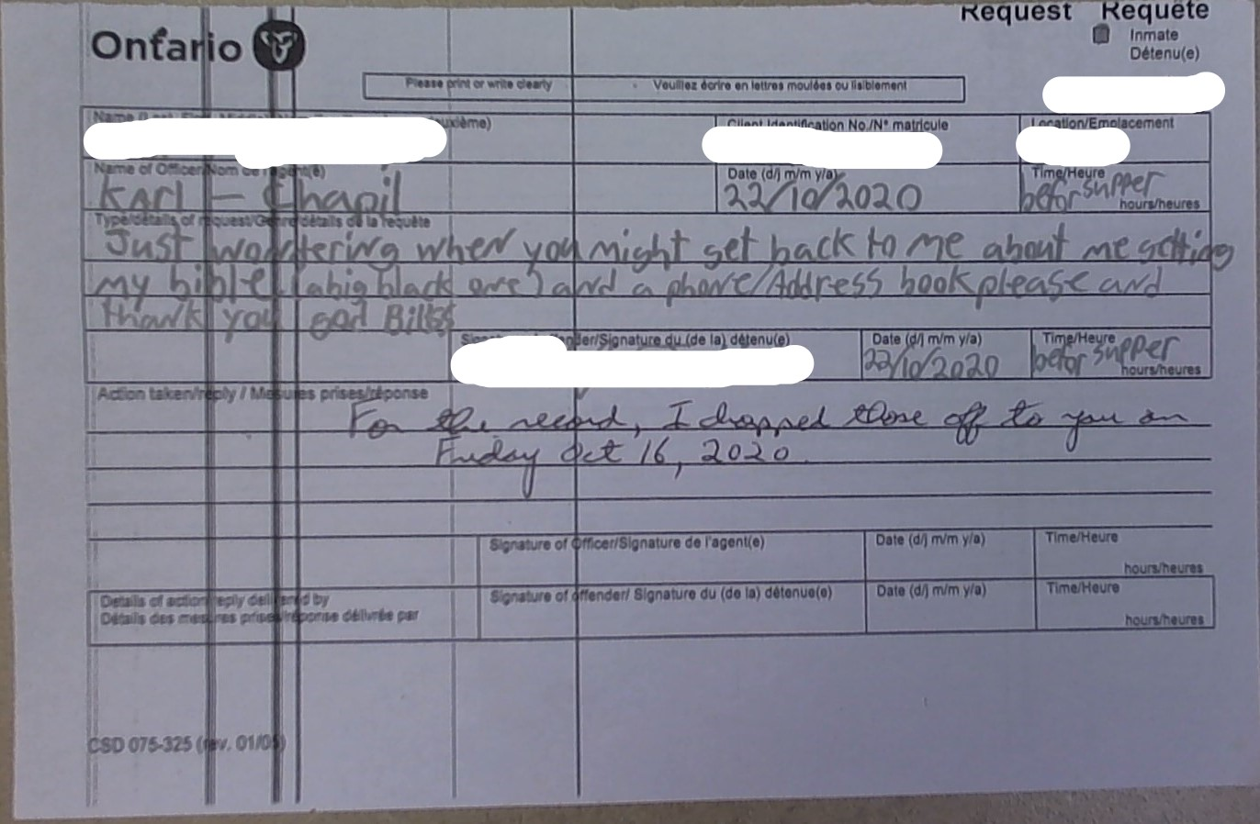
Karl - Chapil

Slide 38
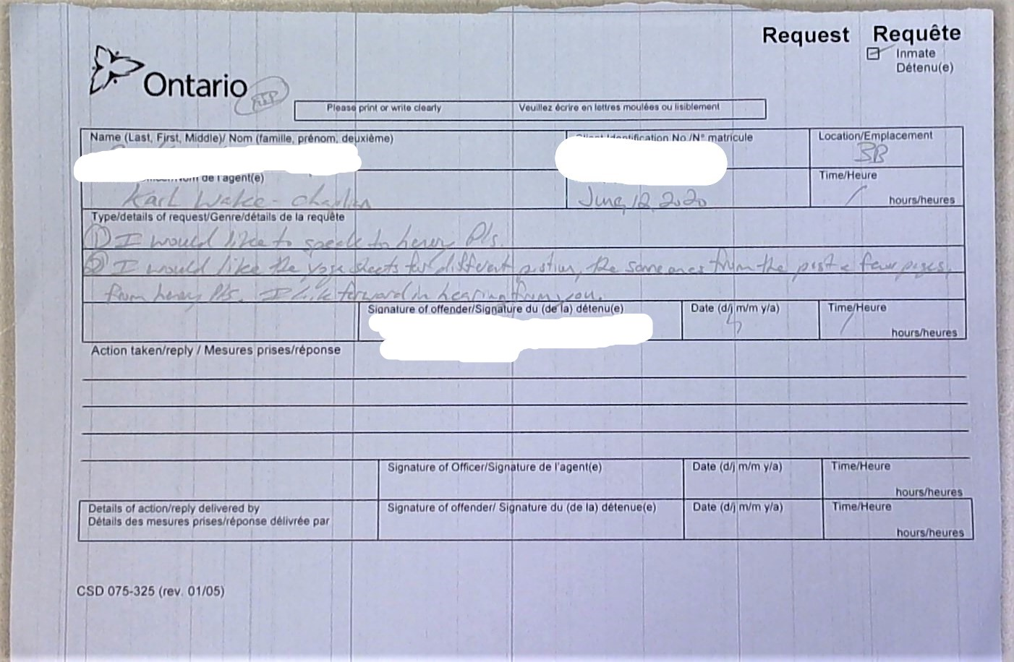
Karl Wake - Chaplian

Slide 39
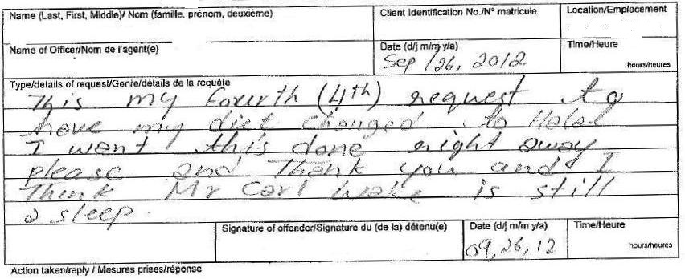
Mr Carl Wake is still asleep

Slide 40
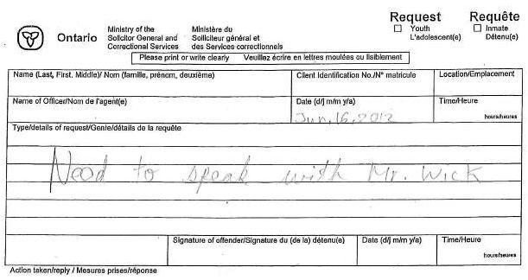
Mr. Wick

Slide 41
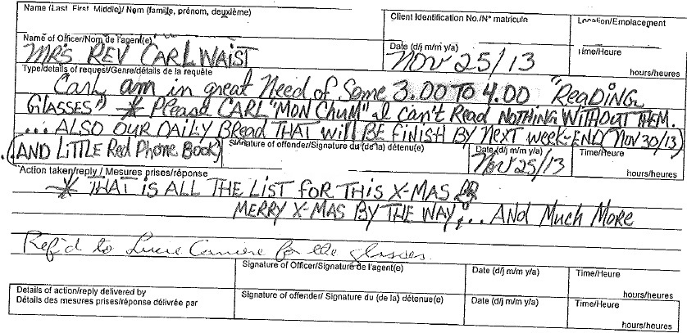
Mrs Rev Carl Waist

Slide 42
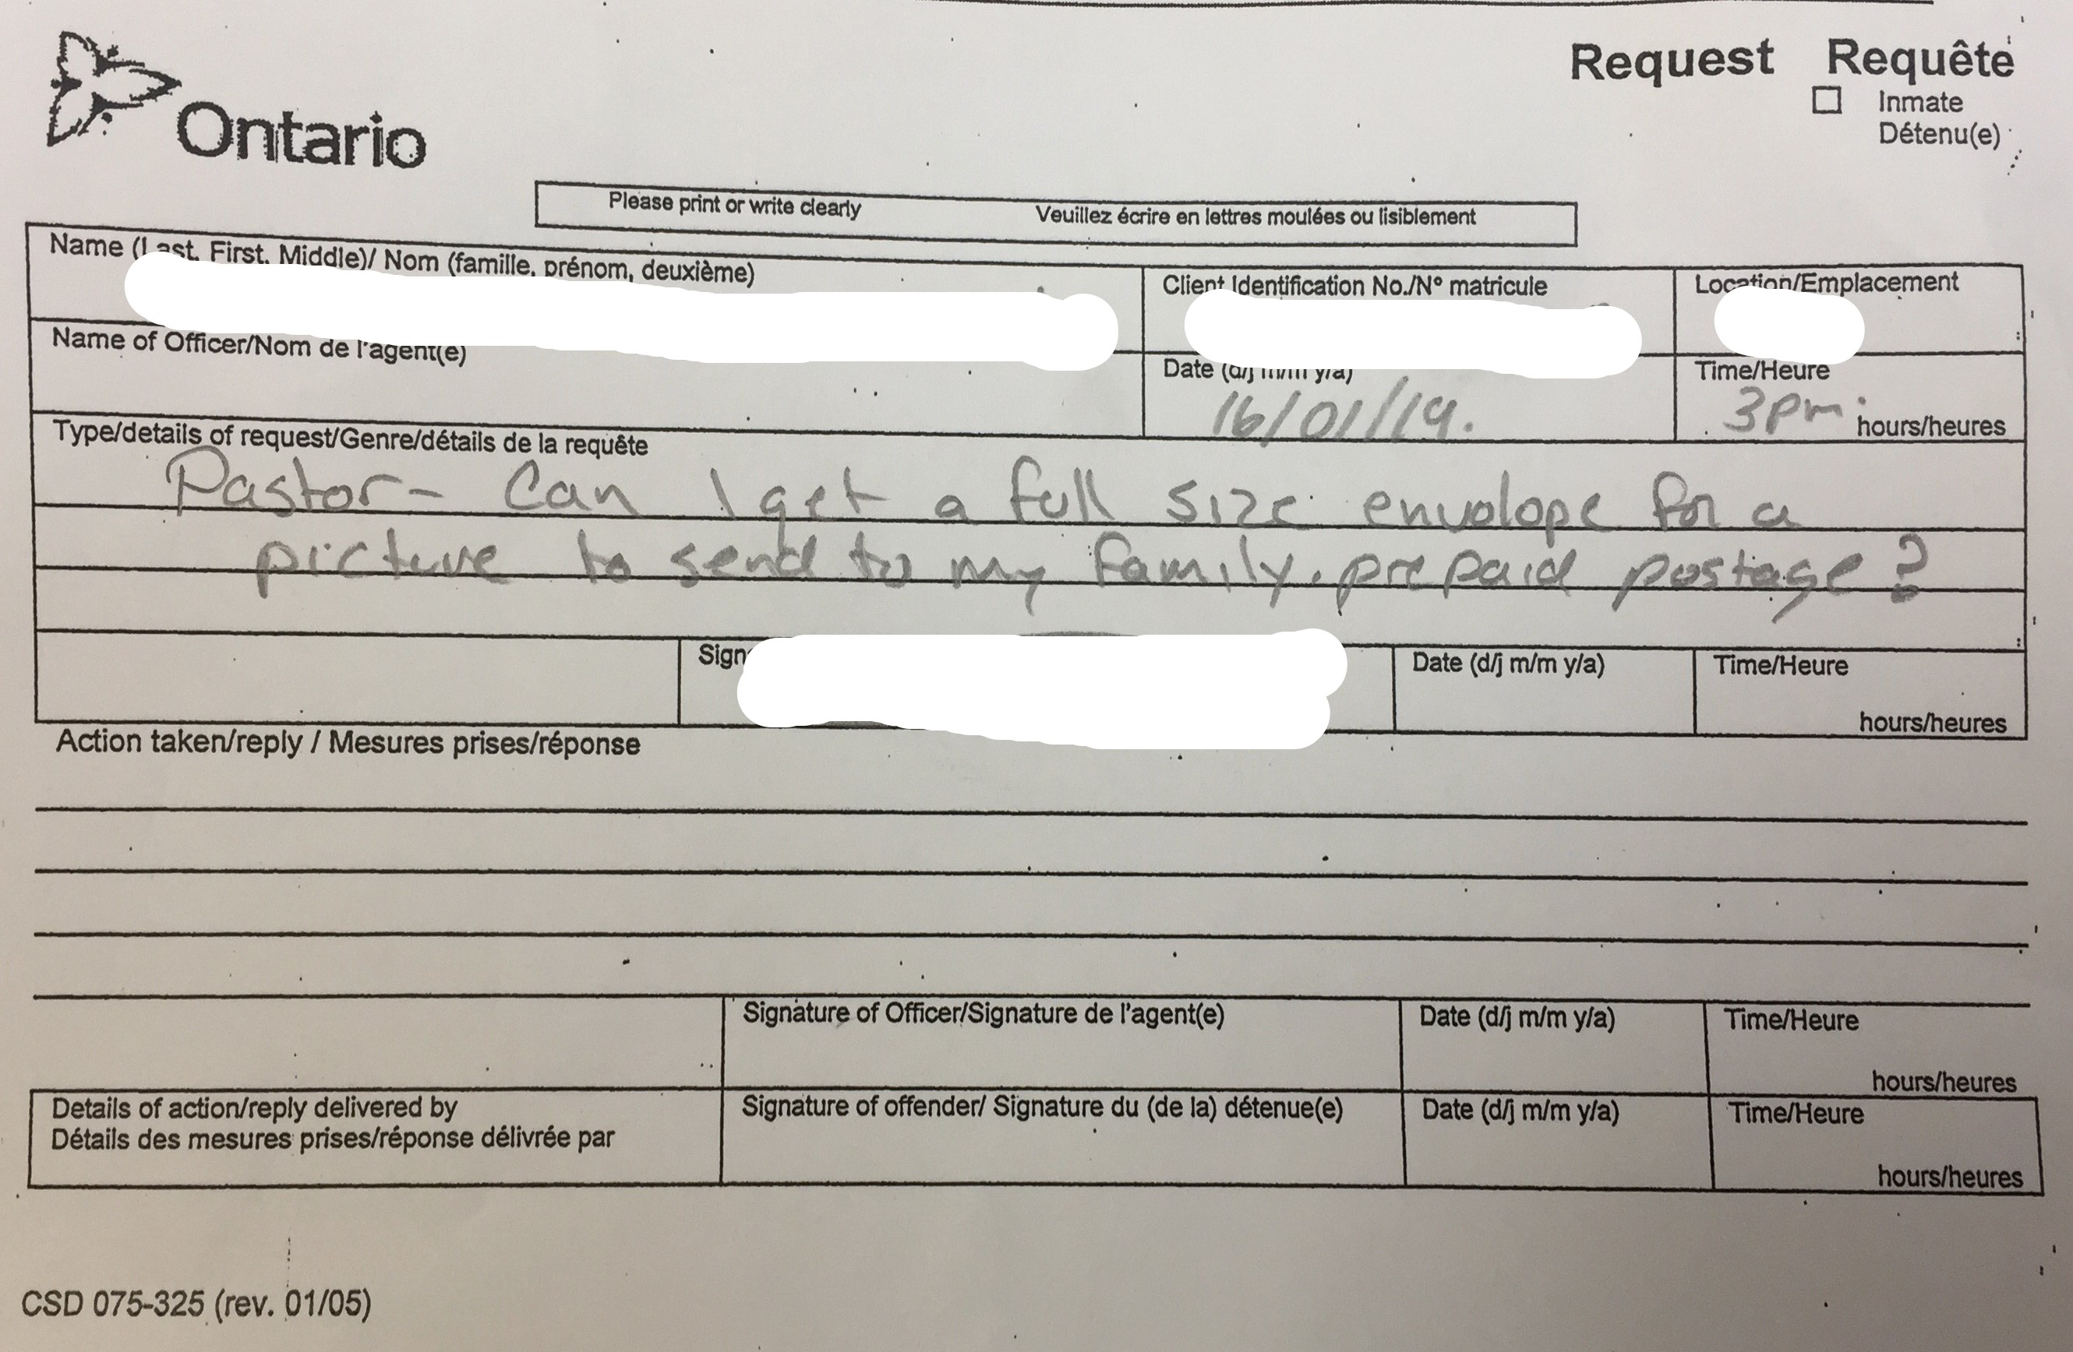
Pastor

Slide 43
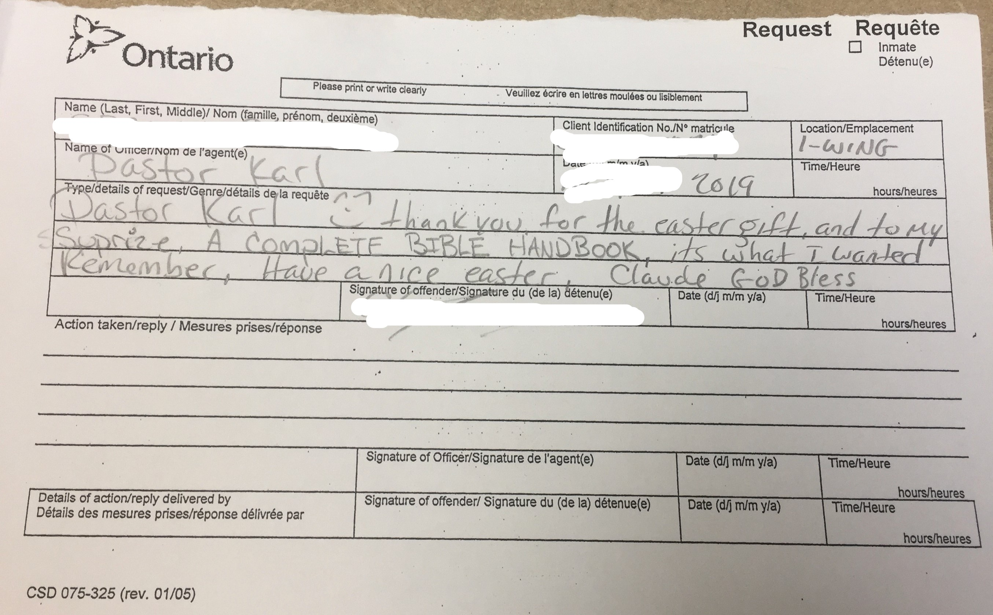
Pastor Karl

Slide 44
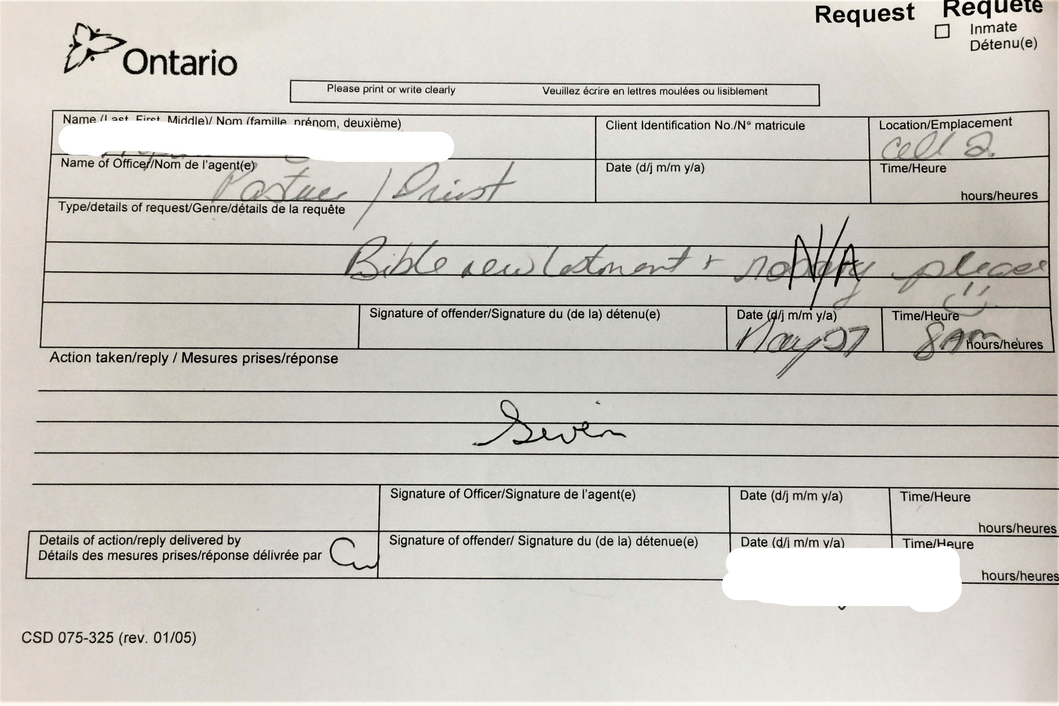
Pastuer / Priest

Slide 45
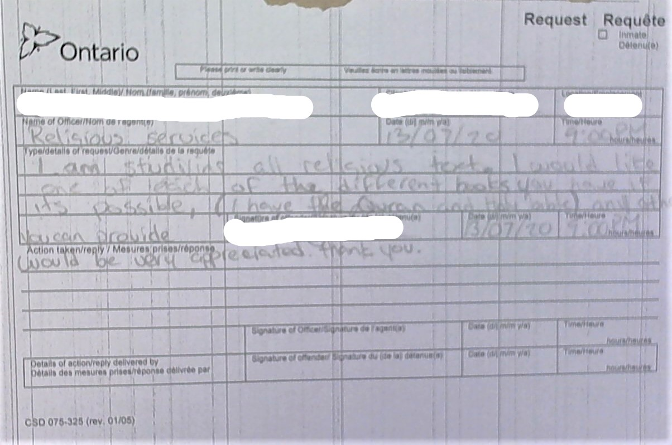
Religious Services

Slide 46
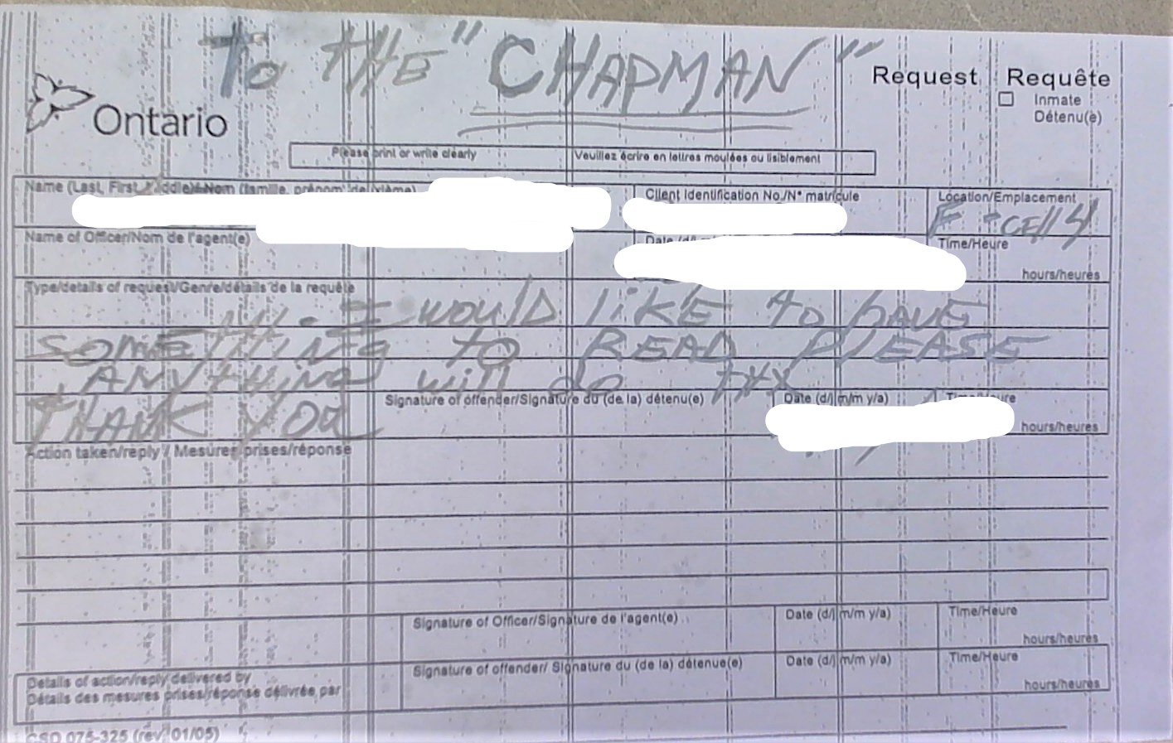
The Chapman

Slide 47
Welcome to the world in which I was privileged to serve.
I did not want to be anywhere else!

Slide 48
Call Me Anything, Just Do Not Call Me Late For Dinner
Rev. Carl Wake, Former Coordinating Chaplain
Ottawa-Carleton Detention Centre

